Slide 1
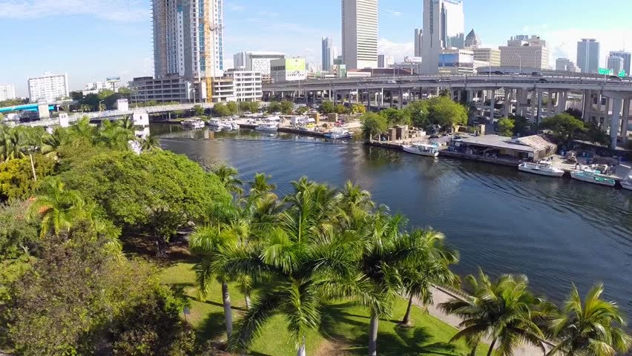

CITIES
MIAMI
Sonia Succar Rodriguez
Cities Program Manager
Notes:
Nothing to say. Start talking at Slide 2.

Slide 2
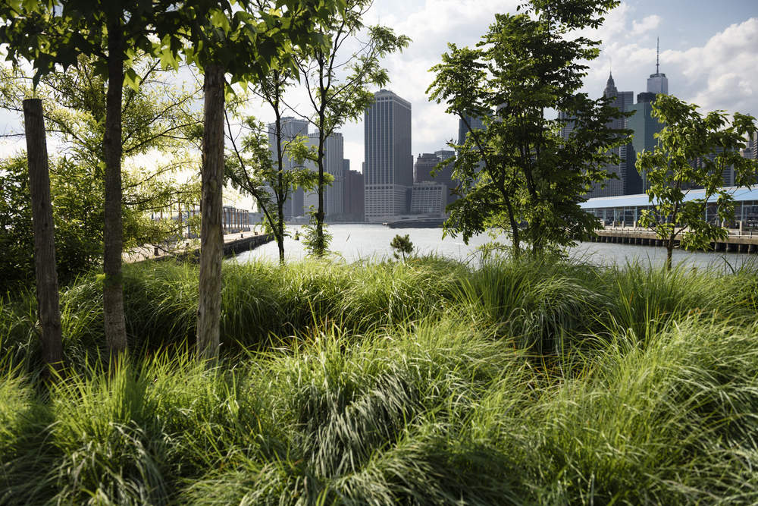
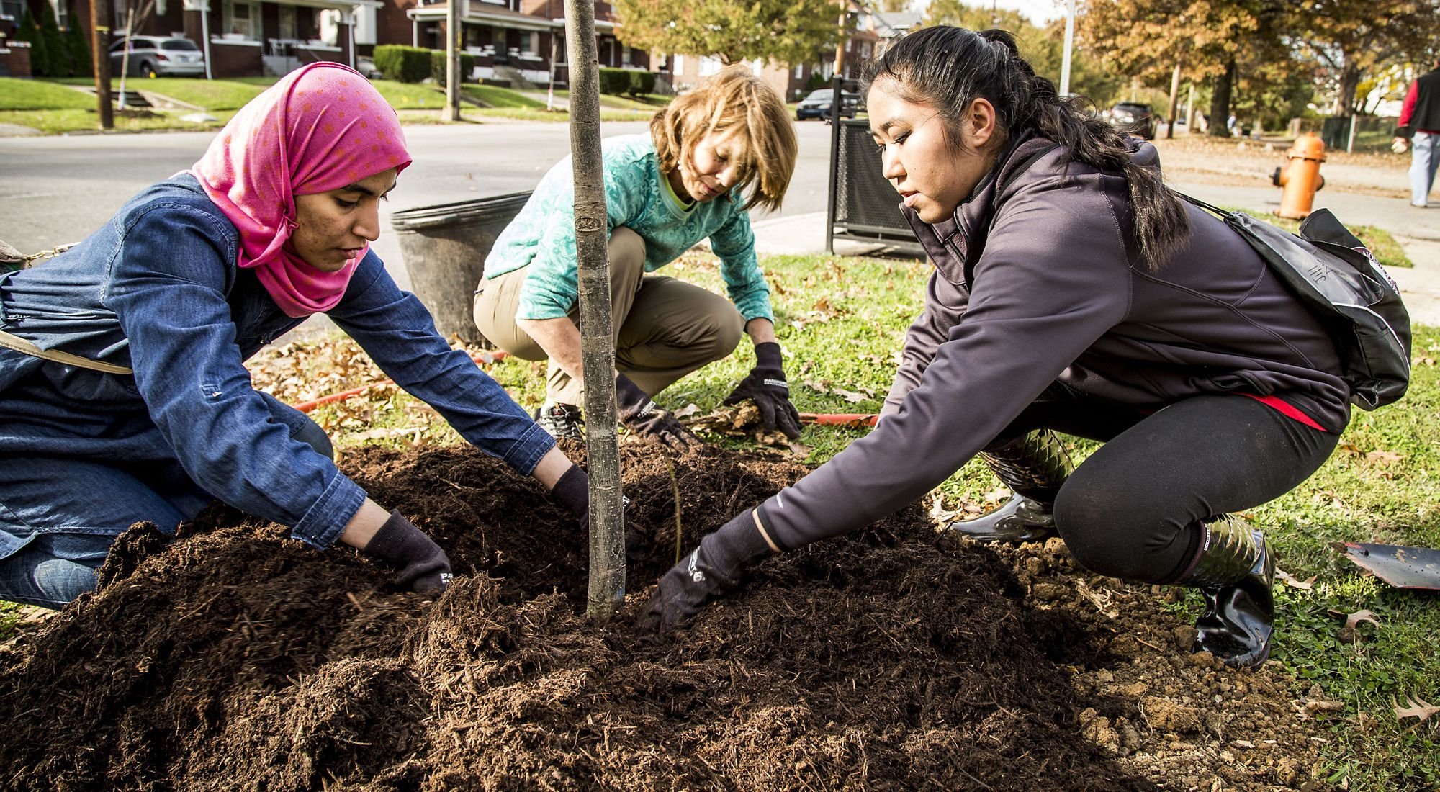
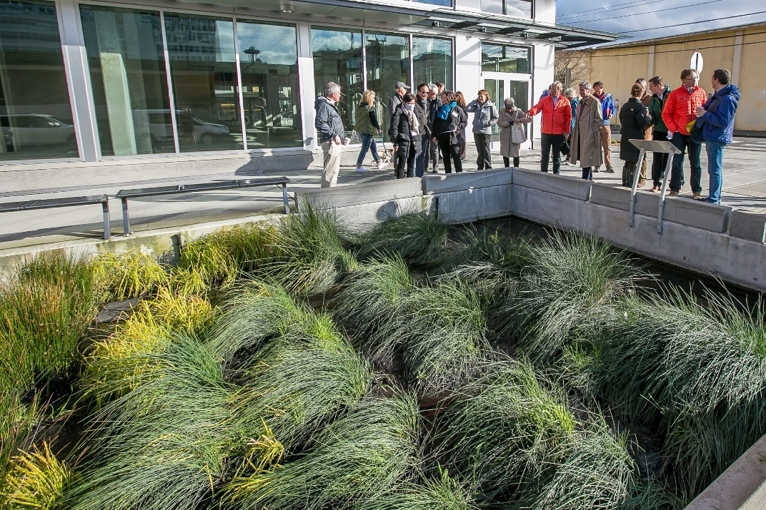
TRANSFORMING THE CITY LANDSCAPE +
OBJECTIVE: Enhance the quality and quantity of open space in cities and ensure the long term health of urban socio-ecological systems, with particular attention to communities who lack quality open space and are most vulnerable to climate change.

Slide 3
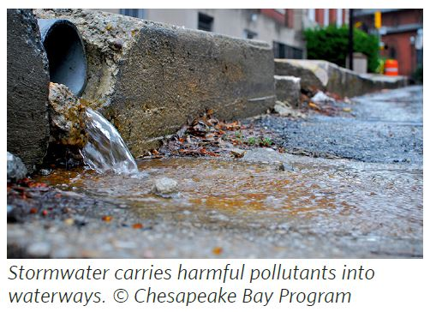
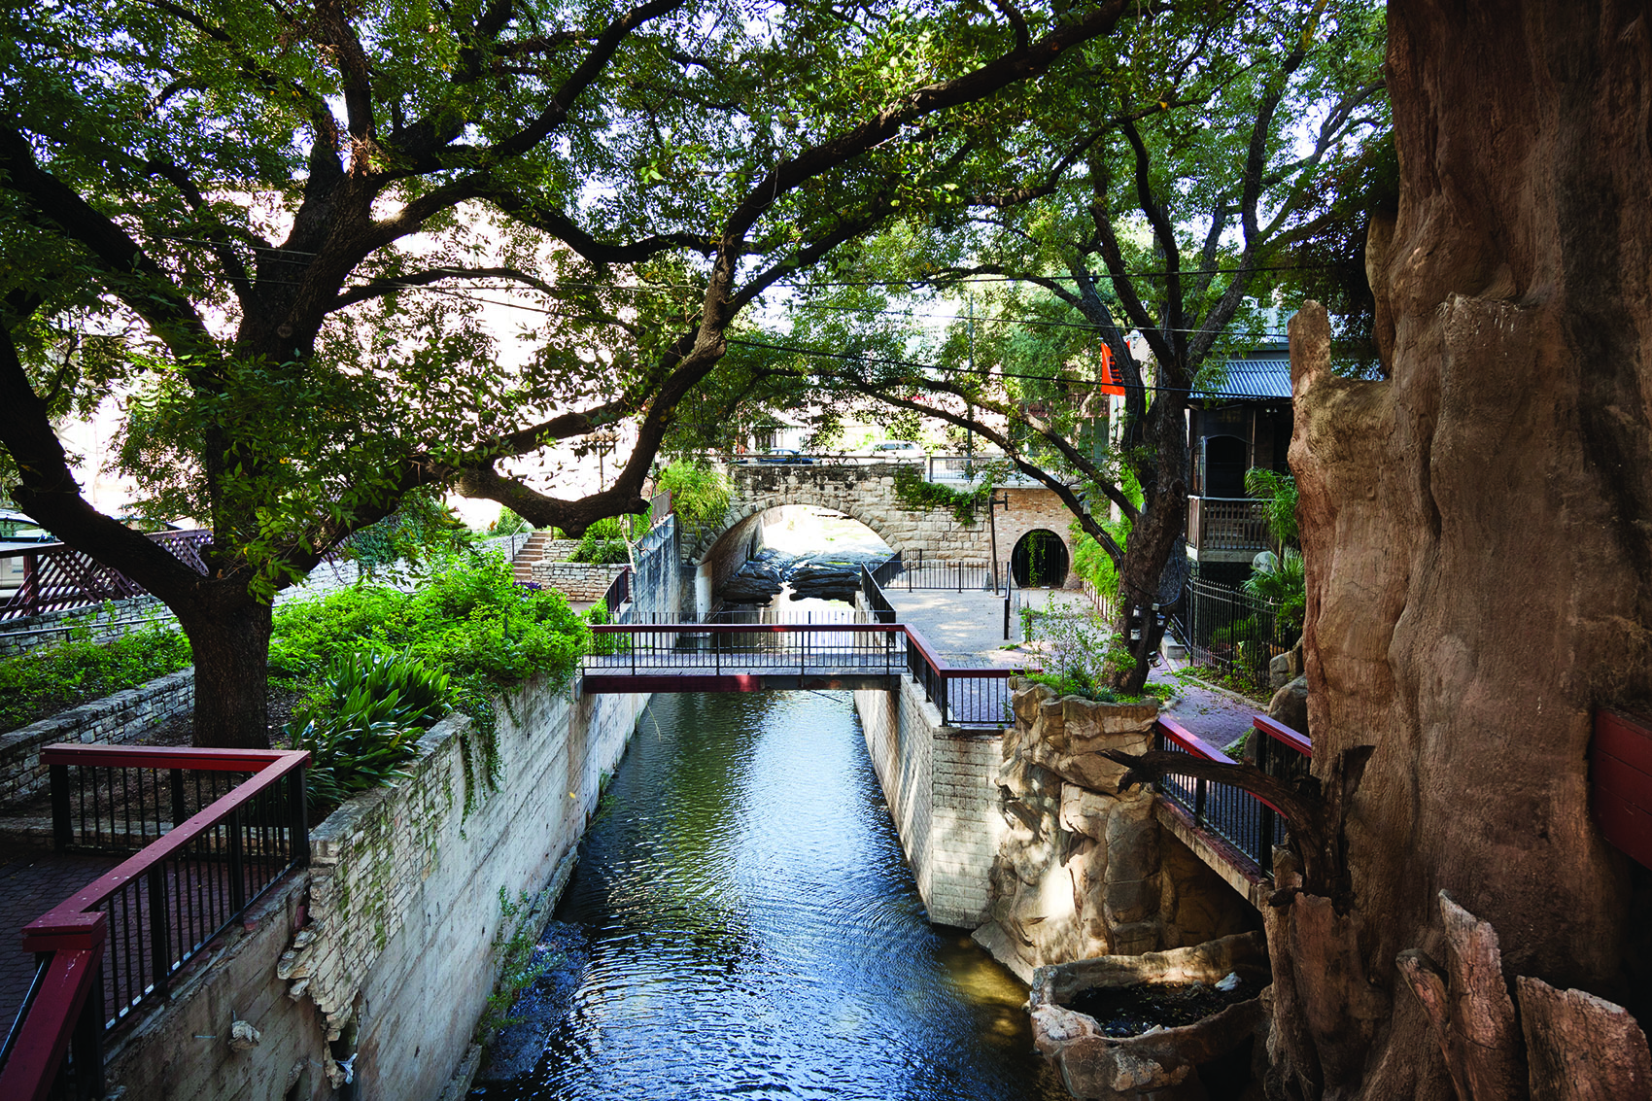
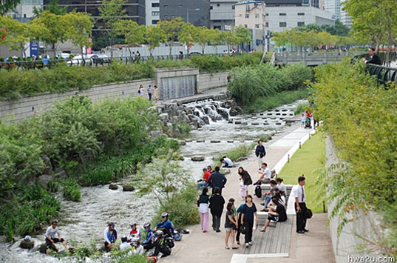
ADVANCING URBAN WATER SOLUTIONS
OBJECTIVE: Create a systemic shift in how urban communities address their water supply, storm water, wastewater and localize flooding challenges towards multi-benefit and integrated solutions to ensure the long term health and safety of urban communities and the natural systems that support them, particularly those most in need and most vulnerable to climate change.

Slide 4
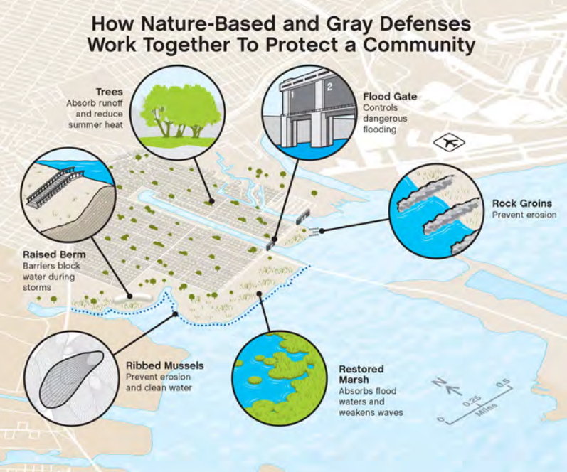
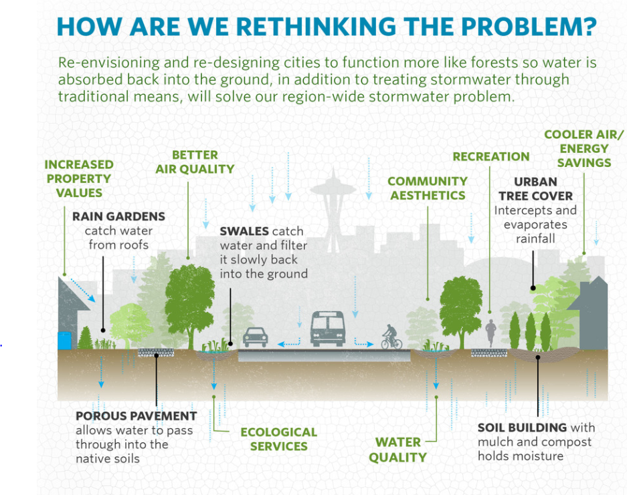
APPROACHES FOR PARKS AND GREEN INFRASTRUCTURE TO PLAY A MORE VITAL ROLE WITHIN SOUTH FLORIDA’S UNIQUE ENVIRONMENT:
Notes:
(15s) Additionally, coastal cities can also add hybrid solutions that combine both nature-based and gray defenses that have shown to drastically reduce storm surge and prevent erosion. These coastal resiliency measures combined with upstream solutions to capture runoff, are quickly becoming the cost-effective model to help shape our future cities.

Slide 5
MIAMI CITIES PROGRAM GOALS
MAP + MODEL + PLAN
CREATE TANGIBLE PROJECTS
ACROSS PILLARS
ENGAGE + COMMUNICATE
Notes:
IN ORDER TO TRANSFORM PROTECT AND INSPIRE, WE NEED TO:

Slide 6
MAP + MODEL + PLAN
  MIAMI RIVER WATERSHED CORRIDOR AND ITS 5 WATERWAYS
  Land Elevation
  Tidal Elevation
  Flood Zones
  Existing Septic Tanks and Outfalls
  Demographics
  Tree Canopy Count
  Greenspace Acreage
  Radius and Walkability to Greenspace, River, Creek and Waterways
  Air Quality and Pollutant Levels
  Transit Corridor and Future Plans

Slide 7
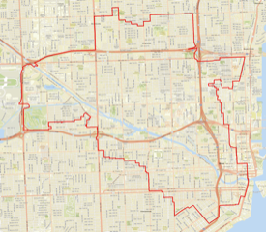
Miami River Watershed
Mapping underway with FIU during this Spring semester, and will include data from the WBID, Miami River Basin Report, and Miami River Site Walkthrough List
Purpose is to present this data in an easily accessible visualizing portal.
Early data results will only be shared with stakeholders, including MRC.
Working with the communities of Little Havana, Overtown and Allapattah
Building out the strategy for community engagement and field activities over the next two years.
Community engagement in this process is key. Working closely with MRC as a partner, and with local, state and federal elected officials.
Notes:
A

Slide 8
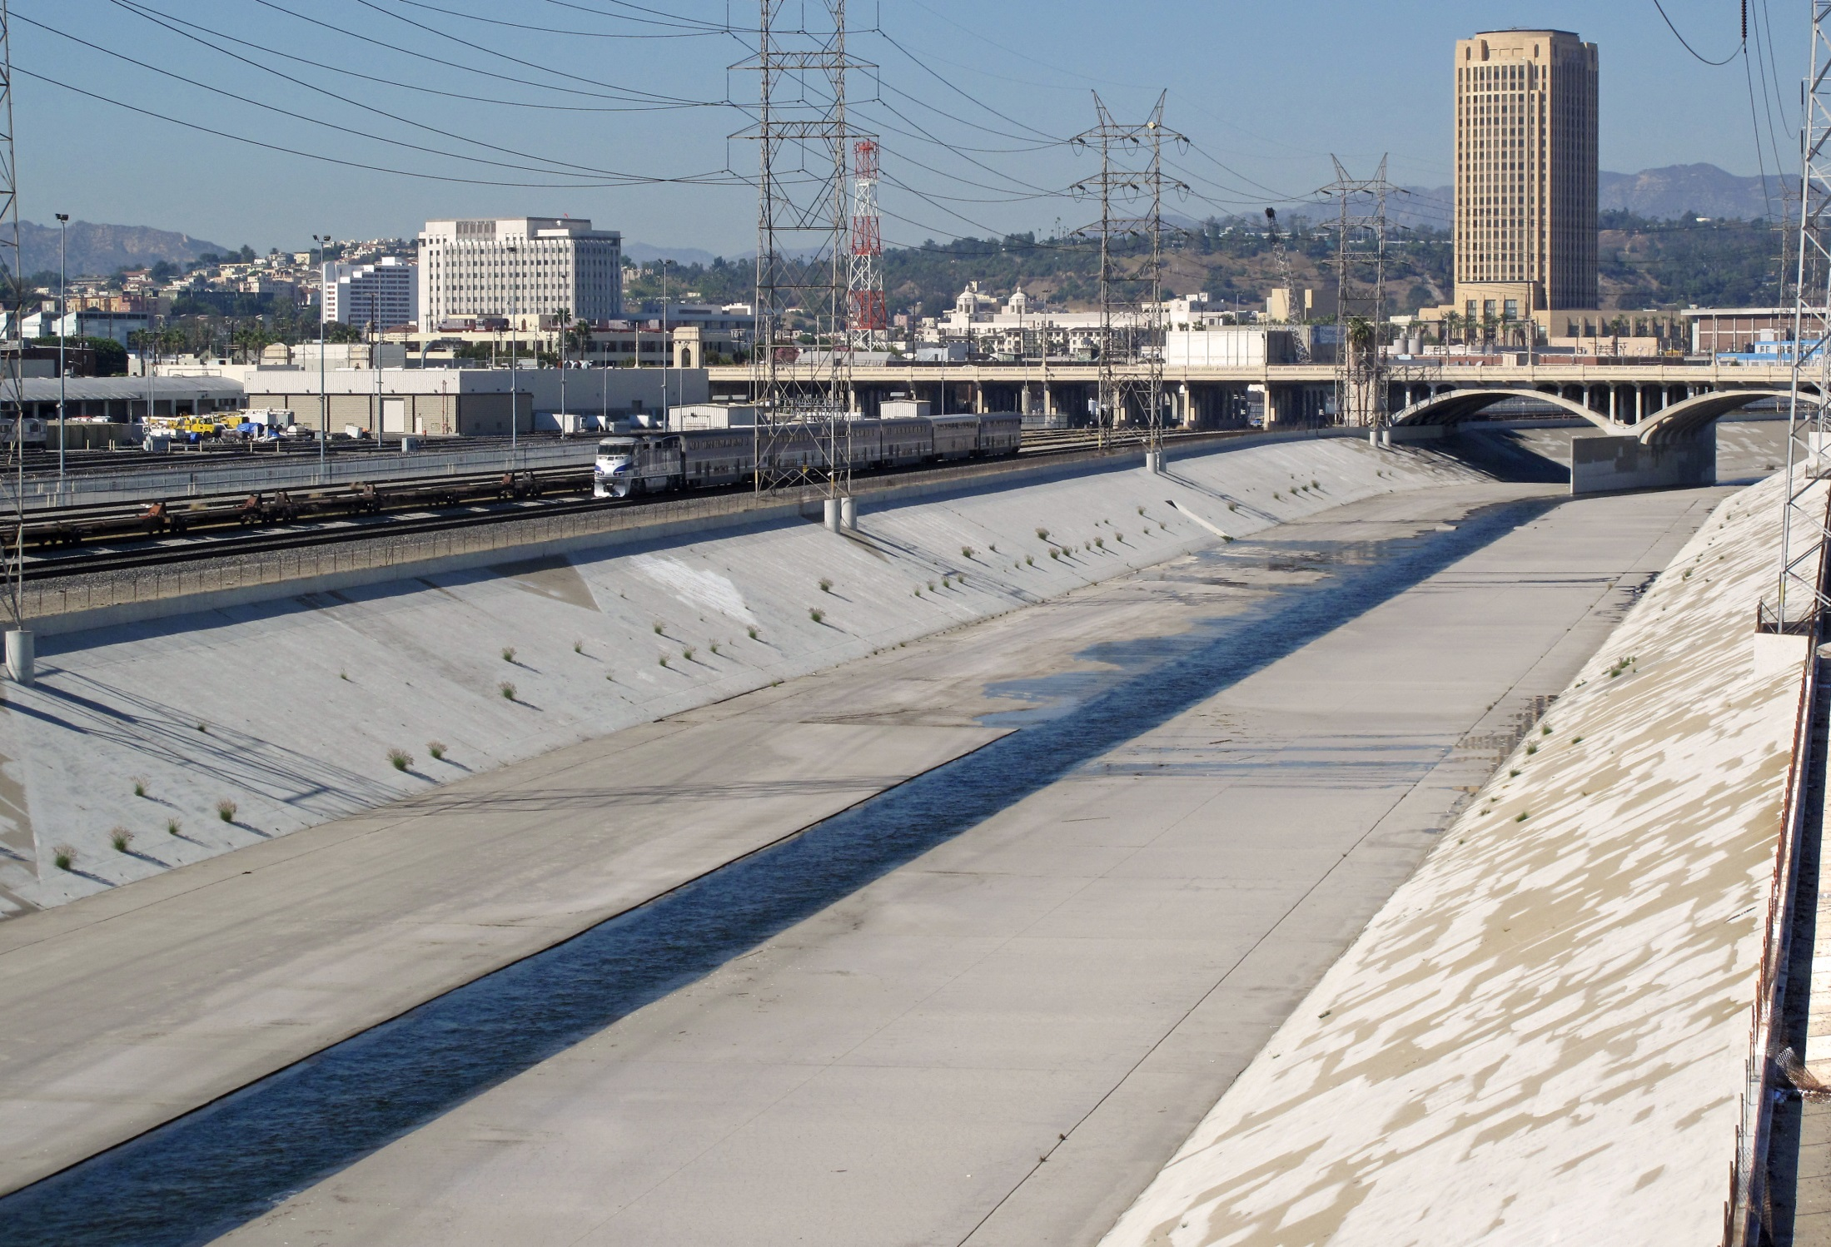
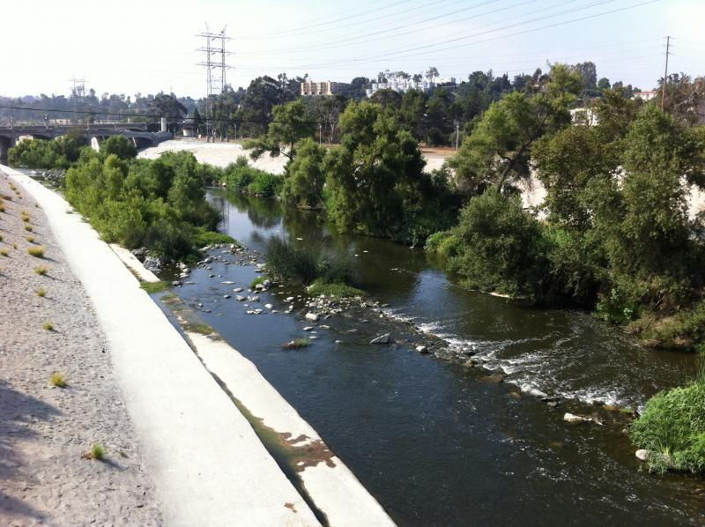
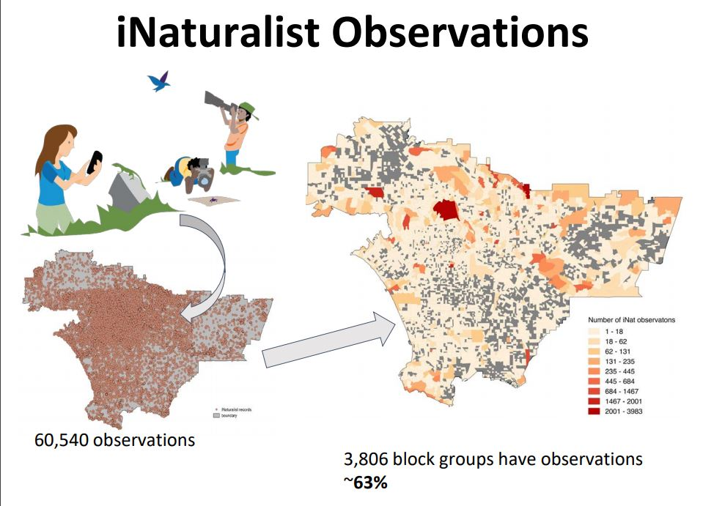
Citizen Science,
Los Angeles River
Notes:
Los Angeles River, a concrete eye sore, starting with the revitalization of 11 miles of their 51 mile river, diverting treated wastewater into the River, and creating marshlands along the River with a bike path.
IN ADDITION, THEY ARE WORKING CLOSELY WITH THEIR SCIENCE AND FIELD TEAMS TO ENGAGE THE PUBLIC IN AN ENGAGING BIODIVERSITY
Biodiversity Analysis, CALLED A BioBlitz - a Citizen Science Activity THAT HAS HELPED TO COLLECTED THOUSANDS OF OBSERVATIONS OF WILDLIFE AND MARINE WILDLIFE IN THIS CORRIDOR (ONE CONGRESSIONAL SEAT IN CALIFORNIA) TO PRESENT FINDINGS OF SPECIFIC WILDLIFE OBSERVED LIVING IN THIS URBAN LANDSCAPE.

Slide 9
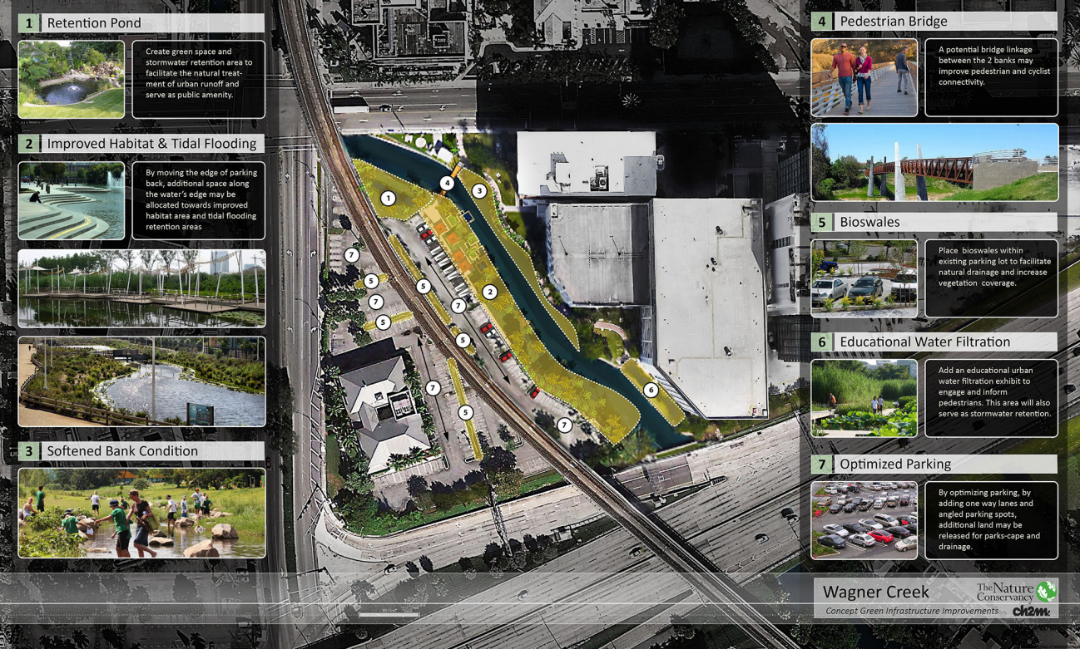
Current Projects
Notes:
TNC LED Projects on public land that were seen yesterday on the Tour. Wagner Creek Jackson Site. Which will be a true demonstration site, and educational site to help educate the public on the benefits, with heavy monitoring of water quantity and water quality, and the shoreline features with wetlands and mangroves. COMPLETION DATE BY APRIL – WORKING TOWARDS EARTH DAY ON APRIL 22ND! AND the Kristi House House site, a larger public park project with these same features, but with more impact that can have more of the public enjoy it and significant visibility from 836 and Metrorail. Both include pro-bono engineering and design services from CH2M/Jacobs Engineering.
ACROSS PILLARS: SCIENCE, FIELD AND STEWARDSHIP TEAM ACTING AS PROJECT MANAGERS. NURSERY FROM OUR BLOWING ROCKS PRESERVE TO SUPPLY SOME OF THE TREES.
Recognize the timeline and how long this has taken since they’ve been hearing about the Creek.

Slide 10
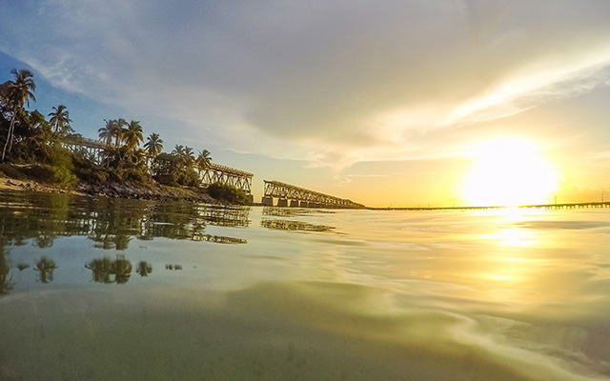
THANK YOU
^{nature.org/florida}
^{Sonia} ^{Succar Rodriguez}
^{Florida Cities - Miami}
^{sonia.succar@tnc.org}
@natureconservancyFL

